Slide 1
Chapter 3
Processes

Slide 2
Outline
OUTLINE
Process Concept
Process Scheduling
Operations on Processes
Inter-process Communication
Examples of IPC Systems
Communication in Client-Server Systems
OBJECTIVES
To introduce the notion of a process -- a program in execution, which forms the basis of all computation
To describe the various features of processes, including scheduling, creation and termination, and communication
To describe communication in client-server systems

Slide 3
Process Concept and Process Management

Slide 4
Process Concept
Process: a program in execution; process execution must progress in sequential fashion
A process includes:
    text – code – section (program counter – PC)
    stack section (stack pointer)
    data section
    set of open files currently used
    set of I/O devices currently used
An operating system executes a variety of programs:
    Batch systems: jobs
    Time-shared systems: user programs or tasks
  We will use the terms job and process almost interchangeably

Slide 5
Process: program in execution
If we have a single program running in the system, then the task of OS is easy:
  load the program, start it and program runs in CPU
  (from time to time it calls OS to get some service done)
But if we want to start several processes, then the running program in CPU (current process) has to be stopped for a while and other program (process) has to run in CPU.
  Process management becomes an important issue
  To do process switch, we have to save the state/context (register values) of the CPU which belongs to the stopped program, so that later the stopped program can be re-started again as if nothing has happened.

Slide 6

Process: program in execution
CPU
(Physical)
Main
Memory
(RAM)
registers
PSW
PC
IR
CPU state
of the process
(CPU context)
process address space
(currently used portion of the address space
must be in memory)

Slide 7
Multiple Processes
one program counter
Process
A
processes
Three program counters
Process
B
C
Process
A
Process
B
Process
C
B
Process
C
A
time
Conceptual model
of three different
processes
what is
happening
physically
one process
executing at
a time

Slide 8
Process in Memory
Stack segment
(holds the called function parameters,
local variables, return values)
Storage for dynamically created
variables
Data segment
(includes global
variables, arrays, etc., you use)
Text segment
(code segment)
(instructions are here)
A process needs this memory
content to run
(called address space; memory image)

Slide 9
Process Address Space
A process can only access its address space
Each process has its own address space
Kernel can access everything

Slide 10
Process State
As a process executes, it changes state
  new: The process is being created
  running: Instructions are being executed
  waiting: The process is waiting for some event to occur
  ready: The process is waiting to be assigned to a processor
  terminated: The process has finished execution
In a single-CPU system, only one process may be in running state; many
processes may be in ready and waiting states.

Slide 11

Diagram of Process State

Slide 12
Process Control Block
Information associated with each process
Process state (ready, running, waiting, etc)
Program counter (PC)
CPU registers
CPU scheduling information
  Priority of the process, etc.
Memory-management information
  text/data/stack section pointers, sizes, etc.
  pointer to page table, etc.
Accounting information
  CPU usage, clock time so far, …
I/O status information
  List of I/O devices allocated to the process, a list of open files, etc.

Slide 13
Process Control Block (PCB)
Process management
Registers
Program Counter (PC)
Program status word (PSW)
Stack pointer
Process state
Priority
Scheduling parameters
Process ID
Parent Process
Time when process started
CPU time used
Children’s CPU time
Memory management
Pointer to text segment info
Pointer to data segment info
Pointer to stack segment info
File management
Root directory
Working directory
File descriptors
User ID
Group ID
……more
a PCB of a process may contain this information

Slide 14
PCBs
Process 1
Process 2
Process 3
Process N
stack
stack
stack
stack
process
address space
data
data
data
data
text
text
text
text
PCB
1
PCB
2
PCB
3
PCB
N
Kernel Memory
Kernel mains a PCB for each process. They can be linked together in various queues.

Slide 15

CPU Switch from Process to Process

Slide 16
Process Representation in Linux
In Linux kernel source tree, the file include/linux/sched.h contains
the definition of the structure task_struct, which is the PCB for a process.
struct task_struct {
long state; /* state of the process */
….
pid_t pid; /* identifier of the process */
…
unisgned int time_slice; /* scheduling info */
…
struct files_struct *files; /* info about open files */
….
struct mm_struct *mm; /* info about the address space of this process */
…
}

Slide 17
Example: Processes in Linux
Use ps command to see the currently started processes in the system
Use ps aux to get more detailed information
See the manual page of the ps to get help about the ps:
  Type: man ps
The man command gives info about a command, program, library function, or system call.
The /proc file system in Linux is the kernel interface to users to look to the kernel state (variables, structures, etc.).
  Many subfolders
  One subfolder per process (name of subfolder == pid of process)

Slide 18
Process Queues and Scheduling

Slide 19
Process Scheduling
In a multiprogramming or time-sharing system, there may be multiple processes ready to execute.
We need to select one them and give the CPU to that.
  This is scheduling (decision).
  There are various criteria that can be used in the scheduling decision.
The scheduling mechanism (dispatcher) than assigns the selected process to the CPU and starts execution of it.
Select
(Scheduling Algorithm)
Dispatch
(mechanism)

Slide 20
Scheduling
Ready queue is one of the many queues that a process may be added
  CPU scheduling schedules from ready queue.
Other queues possible:
  Job queue – set of all processes started in the system waiting for memory
  one process from there
  Device queues – set of processes waiting for an I/O device
    A process will wait in such a queue until I/O is finished or until the waited event happens
Processes migrate among the various queues
Process/CPU scheduling
Device
queue
CPU
Device
Ready
queue
Device
queue
Device
Memory
Job queue

Slide 21

Ready Queue and Various I/O Device Queues

Slide 22
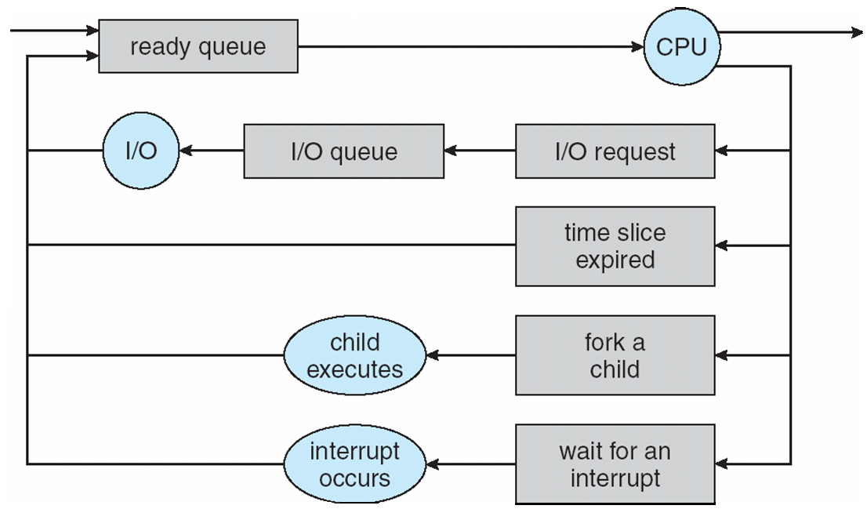
Representation of Process Scheduling
CPU Scheduler
ready queue
I/O queue

Slide 23
Schedulers
Long-term scheduler (or job scheduler) – selects which processes should be brought into the ready queue
Short-term scheduler (or CPU scheduler) – selects which process should be executed next and allocates CPU
Short-term
scheduler
CPU
ready queue
Long-term
scheduler
Main Memory
job queue

Slide 24
Schedulers
Short-term scheduler is invoked very frequently (milliseconds) ⇒ (must be fast)
Long-term scheduler is invoked very infrequently (seconds, minutes) ⇒ (may be slow)
The long-term scheduler controls the degree of multiprogramming
  i.e. number of processes in memory
  Can also control kind of processes in memory!
    What kind of processes will be in memory?
      A good mix of IO bound and CPU bound processes

Slide 25
Process Behavior
Processes can be described as either:
  I/O-bound process – spends more time doing I/O than computations, many short CPU bursts
  CPU-bound process – spends more time doing computations; few very long CPU bursts
    CPU burst: the execution of the program in CPU between two I/O requests (i.e. time period during which the process wants to
    continuously run in the CPU without making I/O)
      We may have a short or long CPU burst.
I/O bound
CPU bound
waiting
waiting

Slide 26

Addition of Medium Term Scheduling
Medium term
scheduler
Medium term
scheduler
Short term
Scheduler
(CPU Scheduler)

Slide 27
Context Switch
When CPU switches to another process, the system must save the state of the old process and load the saved state for the new process via a context switch
Context of a process represented in the PCB
Context-switch time is overhead; the system does no useful work while switching
Time dependent on hardware support

Slide 28
Process Creation and Termination

Slide 29
Process Creation
Parent process create children processes, which, in turn create other processes, forming a tree of processes
Generally, process identified and managed via a process identifier (pid)
Resource sharing alternatives:
  Parent and children share all resources
  Children share subset of parent’s resources
  Parent and child share no resources
Execution alternatives:
  Parent and children execute concurrently
  Parent waits until children terminate
Process
Process
Process
Process
Process
Process

Slide 30
Process Creation (Cont)
Child’s address space?
Child has a new address space.
Child’s address space can contain:
  1) the copy of the parent (at creation)
  2) has a new program loaded into it
UNIX examples
  fork system call creates new process
  exec system call used after a fork to replace the process’ memory space with a new program
  wait system call issued by parent to move itself off the ready queue until the termination of the child
Parent
AS
Child
AS
1)
Parent
AS
Child
AS
2)

Slide 31

Process Creation

Slide 32
C Program Forking Separate Process in Linux
int main()
{
pid_t n; // return value of fork; it is process ID
/* fork another process */
n = fork();
if (n < 0) { /* error occurred */
fprintf(stderr, "Fork Failed");
exit(-1);
}
else if (n == 0) { /* child process */
execlp("/bin/ls", "ls", NULL);
}
else { /* parent process */
/* parent will wait for the child
to complete */
wait (NULL);
printf ("Child Complete");
exit(0);
}
}
Parent
n=?
pid=x
before fork() executed
Parent
n=y
Child
n=0
pid=x
pid=y
after fork() executed
Parent
n=y
Child
pid=x
pid=y
after execlp() executed

Slide 33
Execution Trace: fork()
Process-Parent
Process-Child
stack
n
y
stack
n
0
PC
data
data
….
n=fork();
If (n == 0)
..
else if (n>0)
...
….
n=fork();
If (n == 0)
..
else if (n>0)
...
text
text
CPU
PC
PC
x
pid
y
pid
PCB-Parent
PCB-Child
sys_fork()
{….}
RAM
Kernel

Slide 34
Execution Trace: fork() with execlp()
Process-Parent
Process-Child
stack
n
y
stack
n
0
PC
data
data
….
n=fork();
If (n == 0)
…exec()
else if (n>0)
...
….
n=fork();
If (n == 0)
…exec()
else if (n>0)
...
text
text
new code
CPU
PC
PC
x
pid
y
pid
PCB-Parent
PCB-Child
sys_fork()
{….}
sys_execve()
{….}
RAM
Kernel

Slide 35
Family of exec() Functions in Unix
Program A
Program B
…
execlp(…);
…
…
execv(…);
…
Your Programs
…..
user
mode
execl(...)
{…}
execlp(...)
{…}
execle(...)
{…}
execv(...)
{…}
execvp(...)
{…}
execve(...)
{…}
C Library
sys_execve(…)
{
…
}
kernel
mode
Kernel

Slide 36
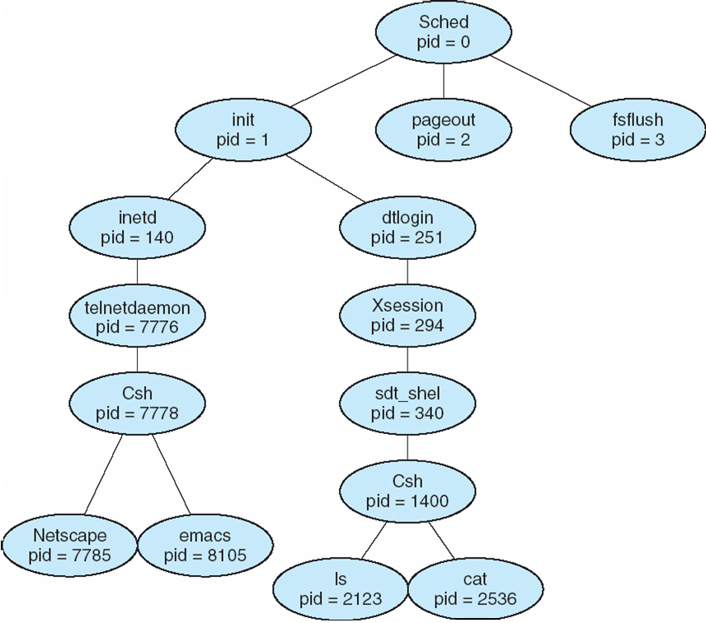
A tree of processes on a typical Solaris
the shell that
a remote user is using
your local shell
your started programs

Slide 37
Creating a Process Using the Win32 API
#include <stdio.h>
#include <windows.h>
int main(VOID) {
STARTUPINFO si;
PROCESS_INFORMATION pi;
// allocate memory
ZeroMemory(&si, sizeof(si));
si.cb = sizeof(si);
ZeroMemory(&pi, sizeof(pi));
// create child process
if (!CreateProcess(NULL, // use command line
“C:\\WINDOWS\\system32\\mspaint.exe”, // command line
NULL, // don’t inherit process handle
NULL, // don’t inherit thread handle
FALSE, // disable handle inheritance
0, // no creation flags
NULL, // use parent’s environment block
NULL // use parent’s existing directory
&si,
&pi))

Slide 38
Creating a Process Using the Win32 API (Cont.)
{
fprintf(stderr, “Create Process Failed”);
return -1;
}
// parent will wait for the child the complete
WaitForSingleObject(pi.hProcess, INFINITE);
printf(“Child Complete);
// close handles
CloseHandle(pi.hProcess);
CloseHandle(pi.hThread);
}

Slide 39
Process Termination
Process executes last statement and asks the operating system to delete it (can use exit system call)
  Output data from child to parent (via wait)
  Process’ resources are deallocated by operating system
Parent may terminate execution of children processes (abort)
  Child has exceeded allocated resources
  Task assigned to child is no longer required
  If parent is exiting
    Some operating systems do not allow child to continue if its parent terminates
      All children terminated - cascading termination

Slide 40
Process Termination
Parent
Child
fork();
….
….
x = wait ();
….
….
….
exit (code);
PCB of parent
PCB of child
sys_wait()
{
…return(..)
}
sys_exit(..)
{
…
}
Kernel

Slide 41
Inter-process Communication (IPC)

Slide 42
Cooperating Processes and the need for
Interprocess Communication
Processes within a system may be independent or cooperating
  Independent process cannot affect or be affected by the execution of another process
  Cooperating process can affect or be affected by the execution of another process
Reasons for process cooperation
  Information sharing
  Computation speed-up
  Modularity (application will
  be divided into modules/sub-tasks)
  Convenience (may be better to
  work with multiple processes)
Application
Process
Process
Process
cooperating process
The overall application is designed
to consist of cooperating processes

Slide 43
IPC Mechanisms
Cooperating processes require a facility/mechanism for inter-process communication (IPC)
There are two basic IPC models provided by most systems:
1) Shared memory model
processes use a shared memory to exchange data
2) Message passing model
processes send messages to each other through the kernel

Slide 44

Communication Models
message passing approach
shared memory approach

Slide 45
Shared Memory IPC Mechanism
A region of shared memory is established between (among) two or more processes.
  via the help of the operating system kernel (i.e. system calls).
Processes can read and write shared memory region (segment) directly as ordinary memory access (pointer access)
  During this time, kernel is not involved.
  Hence it is fast
Process A
shared region
Process B
Kernel

Slide 46
Shared Memory IPC Mechanism
To illustrate use of an IPC mechanism, a general model problem, called producer-consumer problem, can be used. A lot of problems look like this.
  We have a producer, a consumer, and data is sent from producer to consumer.
    unbounded-buffer places no practical limit on the size of the buffer
    bounded-buffer assumes that there is a fixed buffer size
Producer
Process
Buffer
Consumer
Process
Produced Items
We can solve this problem via shared memory IPC mechanism

Slide 47
Bounded-Buffer – Shared-Memory Solution
Shared data
      #define BUFFER_SIZE 10
      typedef struct {
      . . .
      } item;
      item buffer[BUFFER_SIZE];
      int in = 0; // next free position
      int out = 0; // first full position
Solution is correct, but can only use BUFFER_SIZE-1 elements

Slide 48
Buffer State in Shared Memory
Producer
Consumer
item buffer[BUFFER_SIZE]
int out;
int in;
Shared Memory

Slide 49
Buffer State in Shared Memory
Buffer Full
in
out
((in+1) % BUFFER_SIZE == out) : considered full buffer
Buffer Empty
in
out
in == out : empty buffer

Slide 50
Bounded-Buffer – Producer and Consumer Code
while (true) {
/* Produce an item */
while ( ((in + 1) % BUFFER SIZE) == out)
; /* do nothing -- no free buffers */
buffer[in] = item;
in = (in + 1) % BUFFER SIZE;
}
Producer
Consumer
while (true) {
while (in == out)
; // do nothing -- nothing to consume
// remove an item from the buffer
item = buffer[out];
out = (out + 1) % BUFFER SIZE;
return item;
}
Buffer (an array)
in, out integer variable
Shared Memory

Slide 51
Examples of IPC Systems: Unix/Linux Shared Memory
There are two different APIs that provide functions for shared memory in Unix/Linux operating system
  1) POSIX System V API
    This POSIX standard API is historically called System V API.
      System V (System Five) is one of the earlier Unix versions that introduced shared memory
    shmget, shmat, shmdt, …
  2) POSIX API
      POSIX (Portable Operating System Interface) is the standard API for Unix like systems.
    shm_open, mmap, shm_unlink

Slide 52
Examples of IPC Systems –
POSIX Shared Memory API (derived from SV API)
POSIX + System V Shared Memory API
  Process first creates shared memory segment
  segment id = shmget(IPC PRIVATE, size, S IRUSR | S IWUSR);
  Process wanting access to that shared memory must attach to it
  ptr = (char *) shmat(id, NULL, 0);
  Now the process could write to the shared memory
  sprintf(ptr, "Writing to shared memory");
  When done a process can detach the shared memory from its address space
  shmdt(ptr);

Slide 53
Examples of IPC Systems – another POSIX Shared Memory API
The following functions are defined to create and manage shared memory in POSIX API
    shm_open():
      create or open a shared memory region/segment (also called shared memory object)
    shm_unlink():
      remove the shared memory object
    ftruncate():
      set the size of shared memory region
    mmap():
      map the shared memory into the address space of the process. With this a process gets a pointer to the shared memory region and can use that pointer to access the shared memory.

Slide 54
C program illustrating POSIX shared-memory API
#include <stdio.h>
#include <sys/shm.h>
#include <sys/stat.h>
int main() {
/* the identifier for the shared memory segment */
int segment_id;
/* a pointer to the shared memory segment */
char * shared_memory;
/* the size (in bytes) of the shared memory segment */
const int size = 4096;

Slide 55
C Program (Cont.)
/* allocate a shared memory segment */
segment_id = shmget(IPC_PRIVATE, size, S_IRUSR | S_IWUSR);
/* attach the shared memory segment */
shared_memory = (char *) shmat(segment_id, NULL, 0);
/* write a message to the shared memory segment */
sprintf(shared_memory, “Hi there!”);
/* now print out the string from shared memory */
printf(“*%s\n”, shared_memory);
/* now detach the shared memory segment */
shmdt(shared_memory);
/* now remove the shared memory segment */
shmctl(segment_id, IPC_RMID, NULL);
return 0;
}

Slide 56
Message Passing IPC Mechanism
Another mechanism for processes to communicate and to synchronize their actions
With message paasing system processes communicate with each other without resorting to shared variables
This IPC facility provides two operations:
  send(message) – message size fixed or variable
  receive(message)
If P and Q wish to communicate, they need to:
  establish a (logical) communication link
  between them
  exchange messages via send/receive
messages
passed
through
P
Q
Logical
Communication
Link

Slide 57
Implementation in a system
The messaging passing facility can be implemented in various ways.
That means the facility may have different features depending on the system
How are links established?
  Explicitly by the process? Or implicitly by the kernel?
Can a link be associated with more than two processes?
How many links can there be between every pair of communicating processes?
What is the capacity of a link?
Is the size of a message that the link can accommodate fixed or variable?
Is a link unidirectional or bi-directional?

Slide 58
Naming: Identifying the receiver
Naming (how do we identify the receiver)
  Direct naming and communication
    Receiver processes is explicitly specified
      send (P, message) – send a message to process P
      receive(Q, message) – receive a message from process Q
  Indirect naming and communicaiton
    Messages are directed and received from mailboxes (also referred to as ports)
      send (mqid, message)
      receive (mqid, message)
Process
Process
send()
{..
{
receive()
{…
}
Mailbox (mqid)
Kernel

Slide 59
Synchronization (how does the sender behave if can not send message immediately)
  Blocking send/receive
  Non-blocking send/receive
Buffering
  Zero capacity
  Bounded capacity
  Unbounded capacity

Slide 60
Synchronization
How does the sender/receiver behave if it can not send/receive the message immediately
  Depend if Blocking or Non-Blocking communication is used
Blocking is considered synchronous
  Sender blocks block until receiver or kernel receives
  Receiver blocks until message available
Non-blocking is considered asynchronous
  Sender sends the message really or tries later, but always returns immediately
  Receiver receives a valid message or null, but always returns immediately

Slide 61
Buffering
Exact behavior depends also on the Available Buffer
Queue of messages attached to the link; implemented in one of three ways
  1. Zero capacity – 0 messages
  Sender must wait for receiver (rendezvous)
  2. Bounded capacity – finite length of n messages
  Sender must wait if link full
  Unbounded capacity – infinite length
  Sender never waits

Slide 62
Synchronization
Sender
Receiver
Kernel
Buffer
 | Zero Buffer | Some Buffer
Blocking Send | Wait until receiver receives | Wait until kernel receives (if buffer has space no wait)
Blocking Receive | Wait until sender has a message | Wait until kernel has a message (if buffer has space no wait)
Nonblocking Send | Return with receiver received the message or error | Return with kernel received the message or error
Nonblocking Receive | Return with a message or none | Return with a message or none
What if there
would
be infinite
buffer?

Slide 63
Examples of IPC Systems - Mach
Mach communication is message based
  Even system calls are messages
  Each task gets two mailboxes at creation- Kernel and Notify
  Only three system calls needed for message transfer
  msg_send(), msg_receive(), msg_rpc()
  Mailboxes needed for commuication, created via
  port_allocate()

Slide 64
Examples of IPC Systems – Windows XP
Message-passing centric via local procedure call (LPC) facility
  Only works between processes on the same system
  Uses ports (like mailboxes) to establish and maintain communication channels
  Communication works as follows:
    The client opens a handle to the subsystem’s connection port object
    The client sends a connection request
    The server creates two private communication ports and returns the handle to one of them to the client
    The client and server use the corresponding port handle to send messages or callbacks and to listen for replies

Slide 65

Local Procedure Calls in Windows XP

Slide 66
Other IPC methods: pipes
Piped and Named-Pipes (FIFOs)
In Unix/Linux:
  A pipe enables one-way communication between a parent and child
  It is easy to use.
  When process terminates, pipe is removed automatically
  pipe() system call
P
C
pipe

Slide 67
Other IPC methods: named-pipes (FIFOs)
  A named-pipe is called FIFO.
  It has a name
  When processes terminate, it is not removed automatically
  No need for parent-child relationship
  birectional
  Any two process can create and use named pipes.
P1
P2
a_filename
named pipe

Slide 68
Communication Through Network:
Client-Server Communication

Slide 69
Communications in Client-Server Systems
Sockets
Remote Procedure Calls
Remote Method Invocation (Java)

Slide 70
Sockets
A socket is defined as an endpoint for communication
Concatenation of IP address and port
The socket 161.25.19.8:1625 refers to port 1625 on host 161.25.19.8
Communication consists between a pair of sockets

Slide 71

Socket Communication

Slide 72
A date server
import java.net.*;
import java.io.*;
public class DateServer {
public static void main(String[] args) {
try {
ServerSocket sock = new ServerSocket(6013);
// now listen for connections
while (true) {
Socket client = sock.accept();
PrintWriter pout = new PrintWriter(client.getOutputStream(), true);
// write the Date to the socket
pout.println(new java.util.Date().toString());
// close the socket and resume
// listening for connections
client.close();
}
}
catch (IOException ioe) {
System.err.println(ioe);
}
}
}

Slide 73
Date client
import java.net.*;
import java.io.*;
public class DateClient {
public static void main(String[] args) {
try {
// make connection to server socket
Socket sock = new Socket(“127.0.0.1”, 6013);
InputStream in = sock.getInputStream();
BufferedReader bin = new BufferedReader(new InputStreamReader(in));
// read the date from the socket
String line;
while ( (line = bin.readLine()) != null)
System.out.println(line);
// close the socket connection
sock.close();
}
catch (IOException ioe) {
System.err.println(ioe);
}
}
}

Slide 74
Remote Procedure Calls
Remote procedure call (RPC) abstracts procedure calls between processes on networked systems
Stubs – client-side proxy for the actual procedure on the server
The client-side stub locates the server and marshalls the parameters
The server-side stub receives this message, unpacks the marshalled parameters, and peforms the procedure on the server

Slide 75
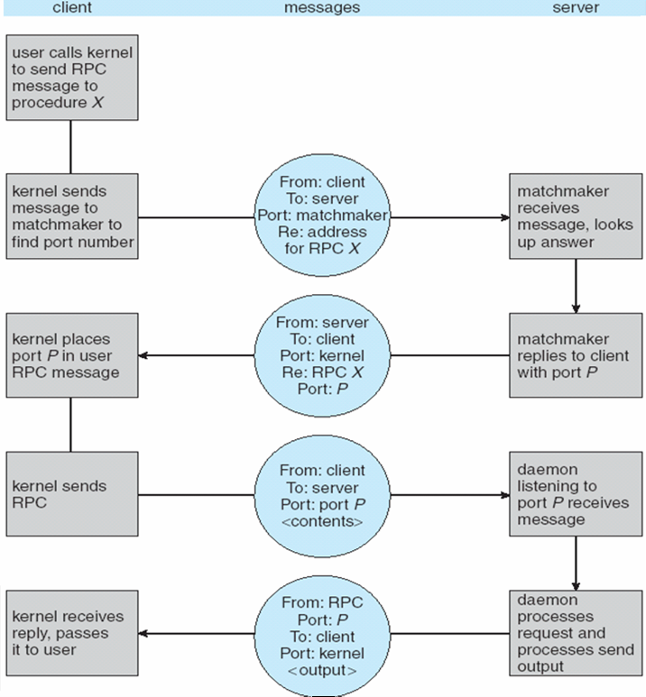
Execution of RPC

Slide 76
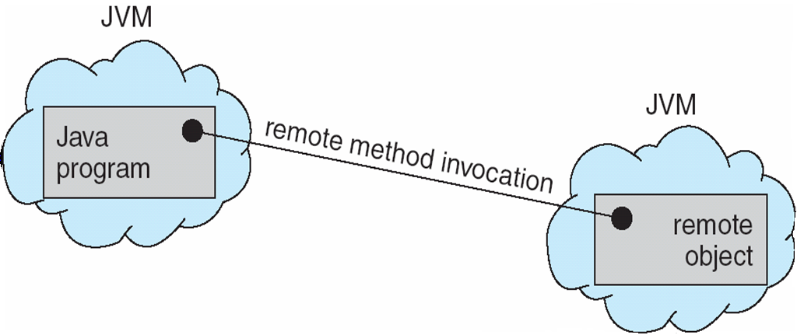
Remote Method Invocation
Remote Method Invocation (RMI) is a Java mechanism similar to RPCs
RMI allows a Java program on one machine to invoke a method on a remote object

Slide 77
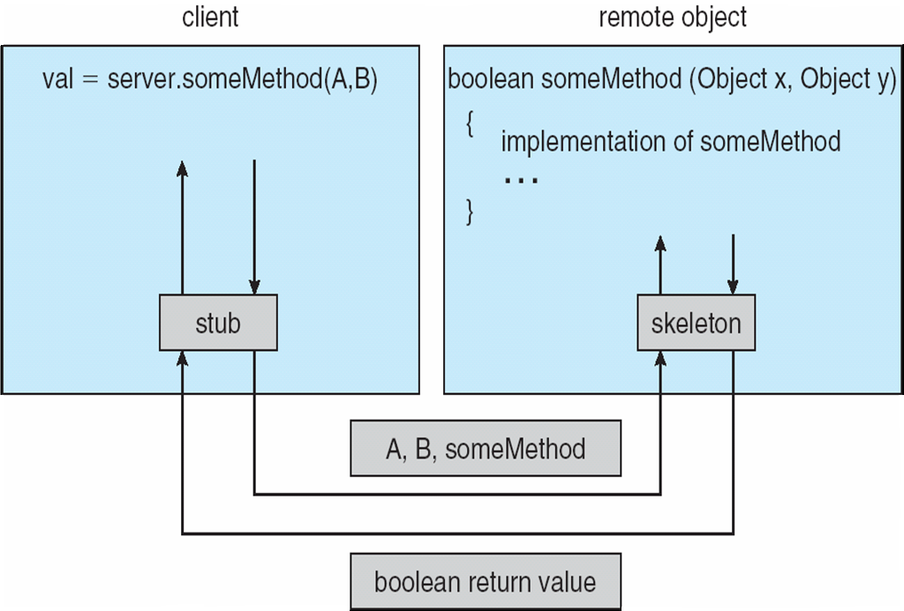
Marshalling Parameters

Slide 78
References
1. Operating System Concepts, 7th and 8th editions, Silberschatz et al. Wiley.
2. Modern Operating Systems, Andrew S. Tanenbaum, 3rd edition, 2009.
3. The slides here are adapted/modified from the textbook and its slides: Operating System Concepts, Silberschatz et al., 7th & 8th editions, Wiley.

Slide 79
Additional Study Material

